Slide 1
Engineering
Mini-MOOC
Fly me to the Moon
Authors : Anne CHIAMA, Frédéric GUILLERAY, Marine ROBINI, Ervan ROUSSEL (France).

Slide 2
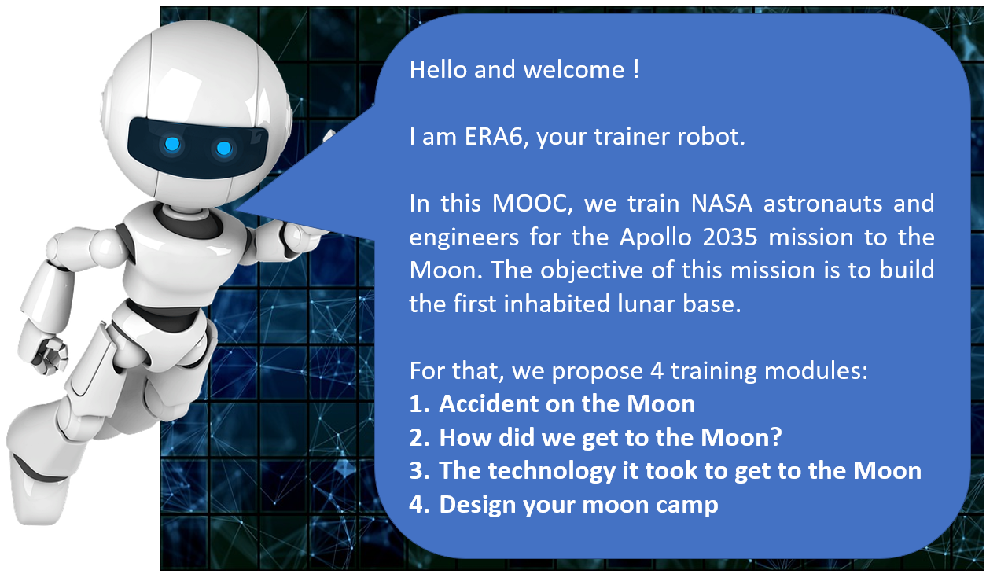
Erasmus+ Programme Partnership – Project n°2019-1-SE01-KA201-060604

Slide 3
Erasmus+ Programme Partnership – Project n°2019-1-SE01-KA201-060604
1. Accident on the Moon (engage)
Instructions for the task
Imagine an accident on the moon : the aim is to find the essential equipment to reach the mother rocket, by classifying 15 objects in order of importance. The exercise is done individually and then in groups.

Slide 4
Erasmus+ Programme Partnership – Project n°2019-1-SE01-KA201-060604
1. Accident on the Moon (engage)
10 minutes : individual ranking
Each participant fills the decision sheet (first column). During this phase, no exchange between the participants is allowed.
30 minutes : collective ranking (working group)
In your group determine a collective ranking of the same elements. Then fill the third column “Collective ranking”.
20 minutes : explanation and score results
Fill the last column with the NASA ranking and calculate the individual and collective score.
Calculation : the score is the difference between your rank and NASA rank. Calculate each line and then the total. The the lower the score, the better the result.

Slide 5
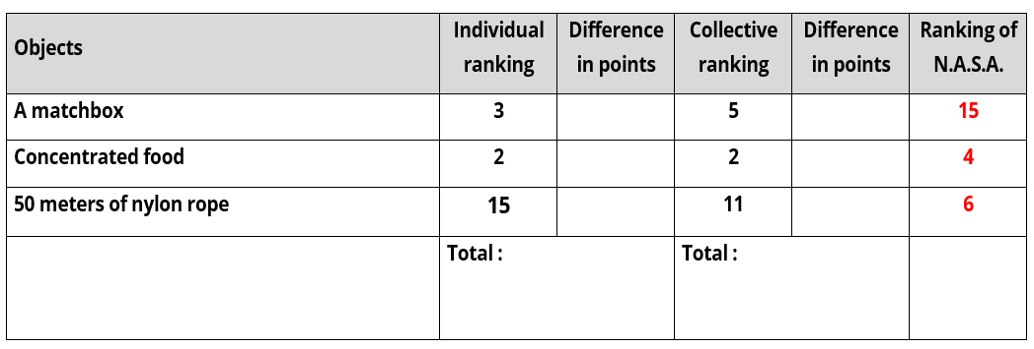
Erasmus+ Programme Partnership – Project n°2019-1-SE01-KA201-060604
1. Accident on the Moon (engage)
How to calculate your score ?
1. Complete the “Rankink of N.A.S.A. column.

Slide 6
Erasmus+ Programme Partnership – Project n°2019-1-SE01-KA201-060604
1. Accident on the Moon (engage)
How to calculate your score ?
1. Complete the “Rankink of N.A.S.A. column.
2. Then, calculate the distance between Individual ranking and N.A.S.A. ranking. Make the individual total.

Slide 7
Erasmus+ Programme Partnership – Project n°2019-1-SE01-KA201-060604
1. Accident on the Moon (engage)
How to calculate your score ?
1. Complete the “Rankink of N.A.S.A. column.
2. Then, calculate the distance between Individual ranking and N.A.S.A. ranking. Make the individual total.
3. Finaly, calcule the distance between Collective ranking and N.A.S.A. ranking. Make the collective total.

Slide 8
Erasmus+ Programme Partnership – Project n°2019-1-SE01-KA201-060604
1. Accident on the Moon (engage)
How to read your score ?
The lawer your score is, the better you are.
In the below example, the individual score is 23 and the collective score is 17. The group has been better than the individual.

Slide 9
Objects | Explanation | ranking of N.A.S.A.
2 tanks of 50 kg of oxygen each | First essential element of survival | 1
25 liters of water | Indispensable to compensate a strong dehydration due to the very great heat on the illuminated side of the moon | 2
A celestial map of the lunar constellations | Essential for orientation | 3
Concentrated food | Efficient way to repair energy loss | 4
A solar powered transceiver (medium frequency) | Useful to try to communicate with the mother rocket but this device does not have much range | 5
50 meters of nylon rope | Useful for roping up, climbing rocks; possibly for hoisting the injured | 6
A medical kit and hypodermic syringes | The injections of vitamins, serum etc...require a special opening (provided by the N.A.S.A.) | 7
A silk parachute | Can be used to protect from sunlight | 8
A self-inflating lifeboat | Can be used as a sled to pull objects; the gas (CO ) used for this device can be used for propulsion | 9
Light signals | Useful when the mother rocket is in sight | 10
2 x 45 caliber pistols | Can be used to accelerate propulsion; in a pinch to end one's life | 11
A case of powdered milk | Nutritional trap: more cumbersome than concentrated food | 12
A solar powered heater | Not useful: suits are heated | 13
A magnetic compass | No use on the moon; the magnetic field is not valued there | 14
A matchbox | The absence of oxygen does not allow them to ignite | 15
Erasmus+ Programme Partnership – Project n°2019-1-SE01-KA201-060604
1. Accident on the Moon (engage)

