Slide 1
Engineering
Mini-MOOC
Fly me to the Moon
Authors : Anne CHIAMA, Frédéric GUILLERAY, Marine ROBINI, Ervan ROUSSEL (France).

Slide 2
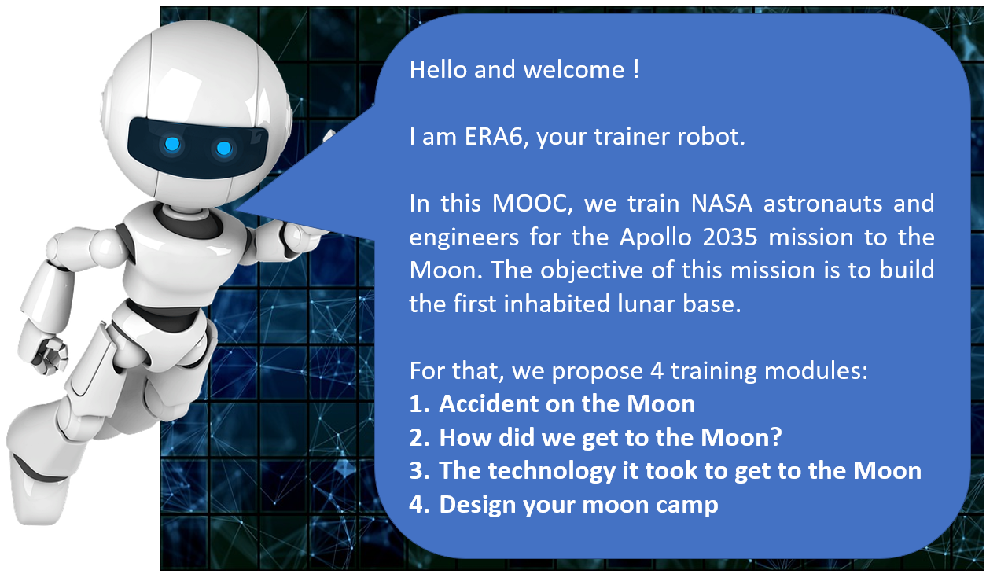
Erasmus+ Programme Partnership – Project n°2019-1-SE01-KA201-060604

Slide 3
Erasmus+ Programme Partnership – Project n°2019-1-SE01-KA201-060604
2. How did we get to the Moon ? (explore)
Instructions for the task
Make a diagram showing the three different ways to go to the Moon imagined by the engineers. For each one, indicate what it implied at the engineering/technological level.
How Apollo 11 made it to the Moon and back – YouTube

