Slide 1
Engineering
Mini-MOOC
Fly me to the Moon
Authors : Anne CHIAMA, Frédéric GUILLERAY, Marine ROBINI, Ervan ROUSSEL (France).

Slide 2
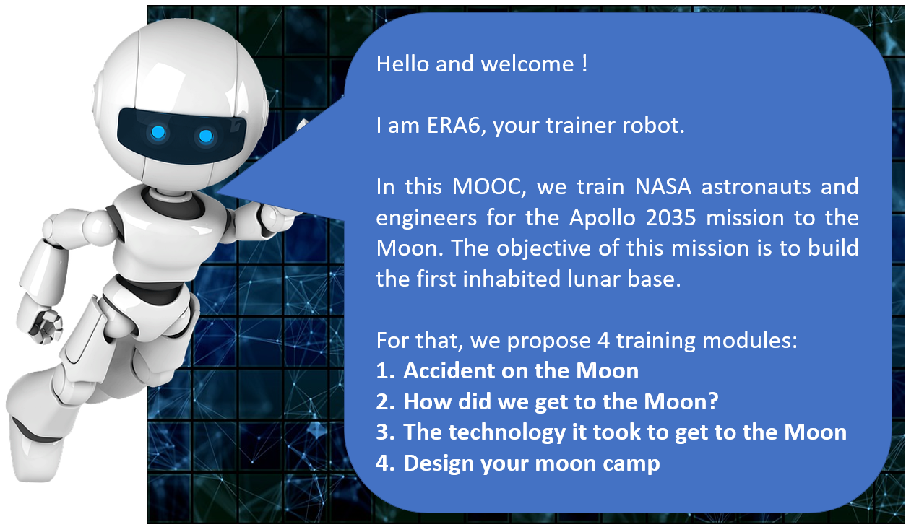
Erasmus+ Programme Partnership – Project n°2019-1-SE01-KA201-060604

Slide 3
Erasmus+ Programme Partnership – Project n°2019-1-SE01-KA201-060604
3. The technology it took to get to the Moon (explain)
Instructions for the task
Each group has 50 minutes to propose a short video in the format of a documentary presenting the technological and engineering advances implemented during the Apollo 11 mission.

