Slide 1
Engineering
Mini-MOOC
Fly me to the Moon
Authors : Anne CHIAMA, Frédéric GUILLERAY, Marine ROBINI, Ervan ROUSSEL (France).

Slide 2
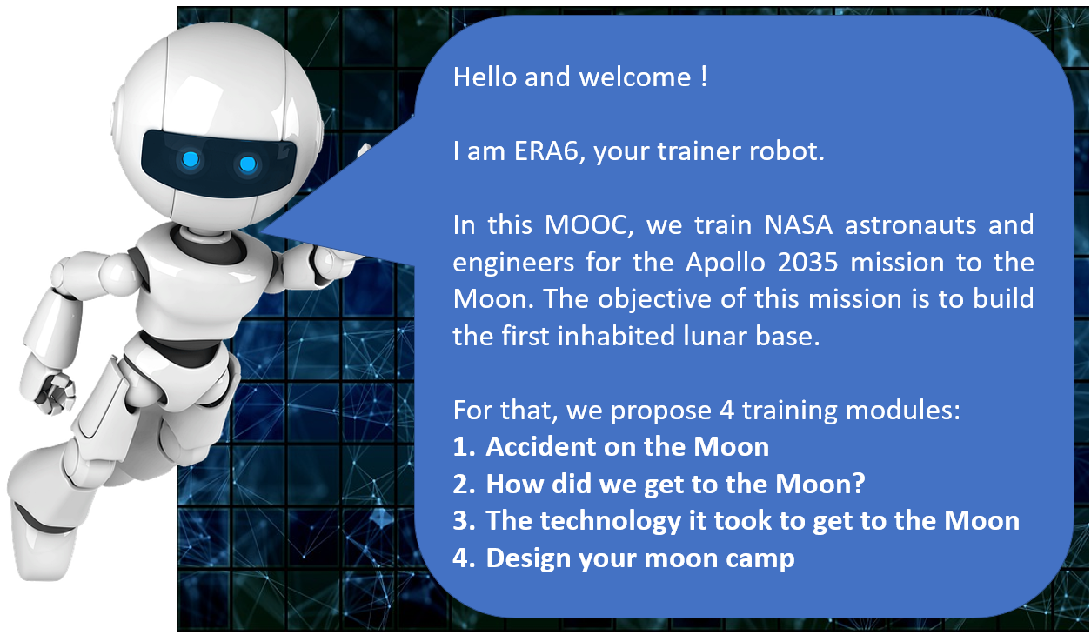
Erasmus+ Programme Partnership – Project n°2019-1-SE01-KA201-060604

Slide 3
Erasmus+ Programme Partnership – Project n°2019-1-SE01-KA201-060604
4. Design your Moon camp (extend)
Instructions for the task
You have 1 hour to design the map of your perfect Moon camp ! You are free to draw what you want and how you want but include information to explain your project and how the settlers will survive.

Slide 4
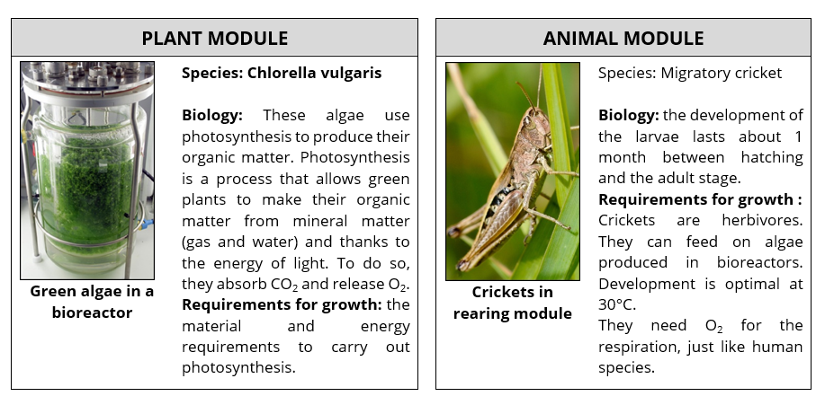
Erasmus+ Programme Partnership – Project n°2019-1-SE01-KA201-060604
4. Design your Moon camp (extend)
The settlers face difficult conditions :
absence of liquid water
no oxygen in the atmosphere
high solar radiation
no food
Moduls that can be used :

